Slide 1

Get ahead of the pack.
Training 101 · An introduction to Claude
A practical half-day on using Claude safely and well, for the brokerages that intend to lead the next five years, not catch up to them.
Prepared for [Practice name] · [Date]
Notes:
Open with the promise, not the agenda. Most of the industry is still experimenting with AI on its own, without training or rules. By the end of today this team will be in the small group that uses it well and has it governed. Everything in the next three hours builds toward that. Swap in the practice name and date before the session.

Slide 2

Six chapters, two hands-on blocks
Today
0:00
Welcome
Who’s running today and why it matters
0:05
1 · The shift
Where the broking market and AI adoption actually stand
0:17
2 · The problem
The squeeze on brokerages, the real risk and what standing still costs
0:35
3 · Choose your tools
Claude vs Copilot vs ChatGPT, the Claude toolkit and who uses what
0:55
4 · How to prompt
The five-part brief, then hands-on: write your own prompts
Hands-on
1:25
Break
10 minutes
1:35
5 · Go further
Memory, skills, planning, models and a live demo
2:15
6 · Lock in the lead
Settings, client data, then hands-on: draft your AI use policy
Hands-on
2:50
Questions
What happens next. Finish at 3:00
Training 101 · An introduction to Claude
02
Notes:
About three hours. A guide, not a script: adjust live, but protect the two hands-on blocks above everything else. If you’re running short, trim chapter 5 before you touch the policy exercise. The story runs in three moves: the market has shifted (chapters 1–2), here’s how to get ahead (3–5), and here’s how to lock that lead in (6).

Slide 3

Who’s running this session
Your facilitator
Sam Cheng
Founder, Locate Digital
1
Background in marketing technology
Ads, tracking, reporting and the systems behind them
2
Leads Locate Digital’s own AI rollout
Claude runs our reporting, content, research and admin
3
Teaches what we use
Everything today comes from real day-to-day work, not theory
Training 101 · An introduction to Claude
03
Notes:
Why I built this session: Sam, this is your own story to tell. Suggested shape: what you saw AI do for your own business, and why you decided to teach it rather than just use it yourself. Keep it to two or three sentences told live.

Slide 4
The broker channel has never been bigger
Chapter 1 · The shift
81.6%
24,116
of new home loans went through a broker in the June 2026 quarter, up from 53.9% in 2018
brokers in Australia, 9.1% more than a year earlier
More borrowers are coming through brokers than ever before, and more brokers are competing for them.
$495.6b
in residential loans settled through brokers in 2025, up 23.5%
Sources: MFAA Quarterly Market Share Report, June 2026 quarter; MFAA State of Mortgage & Finance Broking Report 2026 (Cotality), calendar 2025.
Training 101 · An introduction to Claude
04
Notes:
The broking industry is in the best position it has ever been in. More than four in five home loans now go through a broker. But the number of brokers grew 9.1% in a single year, so the share of the pie is bigger and so is the queue for it. The question for the rest of today: when demand and competition both go up, what separates the brokerages that pull ahead from the ones that just get busier?

Slide 5
AI is already at work, but unevenly
Chapter 1 · The shift
Australian businesses using AI, by size. Most brokerages sit in the first two.
64%
of finance and insurance businesses use AI, second only to property services at around 70%.
80%
60%
33%
38%
69% vs 22%
of Australian employees use AI regularly at work, but only 22% have had any formal training.
Micro (1–4 staff)
Small (5–19)
Mid-market (50–199)
Large (200+)
Sources: NAB/MYOB 2026 (sector, size); Plain English Foundation / National AI Centre, Jan 2026 (employees). Via Locate Digital market research, Sept 2026.
Training 101 · An introduction to Claude
05
Notes:
Most brokerages sit in the two blue bars: micro and small businesses, where adoption is lowest. Large banks and aggregators are already past 80%. That gap is the opportunity, not a reason to feel behind. A ten-person brokerage can move faster than a bank. And the second card is the real story: most people using AI at work have never been shown how.

Slide 6
Brokers believe in AI. Very few have a plan for it
Chapter 1 · The shift
86%
37%
65%
3%
say AI will be essential or helpful to running their business within two years
use AI tools regularly and confidently today
have no documented AI strategy
have formal policies for safe, regulation-aligned AI use
The age gap: 54% of brokers under 50 use AI at work, against 27% of those over 50.
Sources: Connective, AI Readiness in Australian Broking, March 2026 (300+ mortgage, commercial and asset finance brokers); FBAA member poll, March 2026.
Training 101 · An introduction to Claude
06
Notes:
This is the slide to slow down on. Nearly nine in ten brokers think AI matters. Barely a third use it with confidence. Two thirds have no strategy. And only 3% have a formal policy for using it safely. That 3% is the head of the pack, and it’s where this team will be by the end of today. Come back to this number at the close. Note: an earlier version of this deck quoted ‘55% of mortgage brokers use AI daily’. That figure came from a US survey, so it has been replaced with Australian data.

Slide 7
What’s squeezing brokerages right now
Chapter 2 · The problem
Files take longer
Clawbacks bite harder
The average home loan now takes around 20 hours to write, up from 15 five years ago.
The median broker lost $11,442 to clawbacks in 2025, up 16.5% on the year before.
More competition
Checking by eye
24,116 brokers, up 9.1% in a year, chasing the same borrowers and referral partners.
Payslips, bank statements, ID and serviceability inputs, cross-checked by hand on every file.
Marketing gets bumped
More compliance
Social posts, EDMs and follow-ups are the first thing dropped when the pipeline is busy.
Best Interest Duty, responsible lending and, from 10 December 2026, new Privacy Act rules on AI-assisted decisions.
Sources: BrokerEngine via The Adviser (time per loan); MFAA State of Mortgage & Finance Broking Report 2026; Privacy Act amendments on automated decisions.
Training 101 · An introduction to Claude
07
Notes:
Ask the room before you click through: which of these is the biggest drain in your week? Then use their answer in every example for the rest of the day. The common thread is that every one of these steals time from the work only a broker can do: advice, relationships and judgement. Swap in your own team’s pain points if they differ.

Slide 8

Your team is already using AI. Nobody has shown them how, and nobody is checking.
The problem
That’s why it can feel slower than doing the job yourself, and why the risk sits with the licence holder, not the software vendor. It’s a workflow problem, not an AI problem.
Training 101 · An introduction to Claude
08
Notes:
Let this land. Pause after reading the headline. Most people in the room have tried AI. Many will say it wasn’t worth it: the output was generic, or checking it took longer than writing it. That isn’t the tool failing. It’s what happens when nobody has been shown how to brief it, and there’s no agreed way of working.

Slide 9
Under the NCCP, the risk stays with you
Chapter 2 · The problem
Best Interest Duty can’t be outsourced
Responsible lending and BID obligations stay with a person, whatever tool drafted the work.
Ungoverned use is your exposure
A staff member checking documents or drafting advice in an unapproved tool leaves the licence holder carrying the risk.
Free tools and client data don’t mix
The FBAA advises members never to upload client or company personal data into public AI tools.
74%
of Australian advice practices now use AI, up from 45% a year ago. Only 39% have a policy governing how it’s used.
Governed properly, the same task becomes a time-saver instead of an exposure.
Sources: Locate Digital market research, Sept 2026 (advice practices); FBAA guidance to members, March 2026.
Training 101 · An introduction to Claude
09
Notes:
This is the part a principal cares about most. Adoption has outrun governance across the whole finance sector. Under the NCCP Act that gap sits with the licence holder, not the AI vendor. The point isn’t to scare anyone off AI. It’s that the brokerages who get this right will be faster and safer at the same time.

Slide 10

What standing still costs, per broker, per year
Chapter 2 · The problem
~35
× 20 hrs
20%
~$16,000
loans settled per broker a year
of work per loan
of that time handed to Claude
of broker time back each year
≈ 700 hours a year on files
838,815 loans ÷ 24,116 brokers
≈ 140 hours, or 3.5 working weeks
at ~$114 an hour of broker revenue
Total expenditure for a five-broker office
~50×
Time at stake: about 700 hours and $80,000 a year. Claude Team seats for five people: about US$1,200–1,500 a year.
return on the licence cost
Illustrative. MFAA 2026: median upfront $126,941 + trail $77,894 over 1,800 hours. BrokerEngine: hours per loan. 20% is an assumption. claude.com/pricing, Oct 2026.
Training 101 · An introduction to Claude
10
Notes:
Walk through this left to right and invite them to argue with the assumptions. That’s the point: the maths works even if you halve every number. 35 loans a broker is a rough industry average (total loans divided by total brokers). 20 hours a file is contact to settlement. 20% is a conservative share of that work for AI to draft or pre-check, with the broker still reviewing everything. $114 an hour is median upfront plus trail revenue spread over a 1,800-hour working year. Against that, a Claude Team seat is US$20–25 a month. The real cost of AI isn’t the licence. It’s carrying on without it.

Slide 11
Two brokerages, three years from now.
The choice
The one that waited
The one that moved first
Still checking documents line by line
AI pre-checks every file, a broker signs off
Marketing goes out when there’s a spare hour
Posts and EDMs out every week, in the firm’s voice
Staff on free tools nobody approved
One approved tool, a written policy
Competing on rate, because that’s all that’s left
More clients with the same team, without another hire
Training 101 · An introduction to Claude
11
Notes:
This is the ultimatum. Both brokerages have the same market, the same lenders and the same borrowers. The only difference is what they did in the next twelve months. Ask the room: which one are you building? Then move straight into ‘what you’ll get today’, which is the first step toward the right-hand column.

Slide 12
By 3pm, you’ll be ahead of where most of the industry is
Your head start
01
02
03
04
Brief Claude like a capable junior
A habit that works first time
The right tool for every job
Your AI use policy, drafted
Not like a search engine. Clear context, a clear task and an example of good.
A prompting routine that gets a usable answer on the first or second try, not the fifth.
Which Claude tool to open for which task, and for which person on your team.
What’s allowed, what needs sign-off and what’s off-limits, agreed as a team.
No technical skills needed. If you can write an email, you can do everything in today’s session.
Training 101 · An introduction to Claude
12
Notes:
The aim: everyone leaves as the person in their organisation who actually knows how to use this. The go-to, not just another user. Adjust the finish time on the title if your session doesn’t end at 3pm.

Slide 13
Claude, Copilot or ChatGPT: all three beat a free account
Chapter 3 · Choose your tools
Prices in US dollars as at October 2026, annual vs monthly billing. Check current pricing with each vendor before you buy.
 | Claude | Microsoft 365 Copilot | ChatGPT
Where it lives | Web, desktop and mobile. Connects to Microsoft 365 and Google | Inside Word, Excel, Outlook and Teams | Web, desktop and mobile. Connects to common apps
Strongest at | Long documents, careful writing and following detailed instructions | Working across your Microsoft email, files and meetings | General drafting, research and image generation
Business plan | Team: US$20–25 per user a month | Copilot Business: about US$21 per user a month, plus a Microsoft 365 licence | Business: about US$25–30 per user a month
Client data | Business plans aren’t used to train models by default | Covered by Microsoft’s enterprise data protection | Business plans aren’t used to train models by default
Pick it if | You want one capable assistant for drafting, documents and repeatable workflows | Your firm lives in Outlook and Teams and wants AI inside them | Your team already knows it and needs broad, general use
Training 101 · An introduction to Claude
13
Notes:
Be even-handed here. The room will have people who already use ChatGPT or have Copilot through Microsoft 365, and that’s fine. Any business plan is a step up from staff using free personal accounts, which is where the real risk sits. Why we teach Claude: it’s strong on long documents and careful writing, which is most of a broker’s paperwork, and its Projects, Skills and Docs make good work repeatable. Most of today’s prompting habits transfer to the other two. Pricing changes often. Confirm current prices on each vendor’s site within a week of the session. Claude Team pricing is from claude.com/pricing; Copilot and ChatGPT figures are from vendor-reported and third-party sources.

Slide 14
One assistant, six ways to work with it
Chapter 3 · Choose your tools
Claude (chat)
Claude Docs
Quick questions and bigger multi-step jobs in one conversation. Web, desktop and mobile.
Build documents together, section by section. Comment, share by link and edit on mobile.
Claude Slides
Projects
Ask for a deck, refine it together, then export to PowerPoint or PDF.
A workspace that remembers your templates, files and instructions for ongoing work.
Platform update
Claude Code
Claude Design
Claude chat and the old Cowork tab are now one interface. Claude handles simple questions and multi-step work in the same conversation.
Works inside your files and systems. This is where repeatable automation lives.
Visual work checked against your brand’s colours, type and spacing.
Training 101 · An introduction to Claude
14
Notes:
Quick reference: fast question, use chat. Recurring written content, Docs. Need a deck, Slides. Ongoing client or topic work, Projects. Work inside your own files, repeated, Claude Code. Anything visual and on-brand, Design. If anyone remembers choosing between ‘Chat’ and ‘Cowork’, that choice no longer exists. Anthropic merged them in September 2026.

Slide 15
Every role gets a different head start
Chapter 3 · Choose your tools
Role | Start with | First jobs to hand over | Stays with the person
Principal or director · Runs the practice | Projects, Docs | Monthly performance summaries, policy drafts, business planning notes | Final calls on risk, pricing and people
Broker or credit adviser · Client-facing | Chat, Projects | Pre-meeting client summaries, needs-analysis notes, plain-English loan comparisons | The recommendation, and Best Interest Duty
Loan processor · Credit assistant | Chat, Projects | Document checklists, flagging mismatches across payslips and statements, lender policy look-ups | Verifying every flag before a file is submitted
Client services and admin · Inbox and follow-ups | Chat, Routines | Status updates, follow-up emails, inbox sorting, settlement reminders | Anything that goes to a client
Marketing or BDM · Referral partners | Docs, Slides, Design | Weekly social posts and EDMs, referral partner updates, event and webinar decks | Approving every piece before it’s published
Training 101 · An introduction to Claude
15
Notes:
This is the page people photograph. Ask each person to find their row and pick one job from the third column to try this week. The right-hand column matters as much as the third. AI prepares the work; your people make the decisions that matter. That line comes straight from how we set up every client.

Slide 16
Docs and Slides: build the work with Claude
Chapter 3 · Choose your tools
Claude Docs
Claude Slides
A living document you build with Claude, not a one-off export you paste into Word.
Ask for a presentation, Claude builds it, and you refine it together.
Ask for a section, Claude drafts it, you comment and it revises in place
Shareable by link and editable on mobile, so a colleague can review without the original chat
Good for your AI use policy, captions, copywriting and document analysis
Same collaborative model as Docs, section by section
Export to PowerPoint or PDF when you’re ready to present
Parts of today’s deck were built this way
Tip: Ask for a first draft, then refine. For exact brand matching, pair it with Claude Design or your own template.
Tip: Use Docs instead of drafting in chat and copy-pasting. You keep the history in one place.
Training 101 · An introduction to Claude
16
Notes:
If time allows, show the AI use policy draft from this workshop as a live Doc. It’s the clearest example of a document that gets revisited over more than one sitting.

Slide 17
Routines: work that runs while you’re with clients
Chapter 3 · Choose your tools
A prompt or task that runs on a schedule (daily, weekly or on a trigger) without you opening a session. It runs in Anthropic’s cloud, so it fires even with your laptop closed.
An example week
Mon 7:00
Drafts this week’s posts and EDM
1
Available on Pro, Max, Team and Enterprise
Your team approves
2
Start low-stakes and human-reviewed
Wed 8:00
Summarises rate and lender news
Same governance rule as everything else today
Your team reads
3
Let it prepare, never send
Fri 3:00
Drafts follow-ups for new enquiries
A person approves anything that reaches a client
Your team sends
Training 101 · An introduction to Claude
17
Notes:
Keep this grounded. Routines are powerful, but the governance principle from earlier still applies: AI prepares, a person decides. Start with something low-stakes like a weekly content draft before anything touches a client file.

Slide 18
Visionary vs executor
Chapter 4 · How to prompt
Has the ideas
Does the work
The visionary
The executor
Sees what’s possible and spots the opportunity in a changing market
Ideas without execution don’t move the business
Limited by time when volume is high
Only so many hours to check documents or write follow-ups by hand
AI lets you be both at once: the visionary giving direction, with a tireless executor working under it.
Training 101 · An introduction to Claude
18
Notes:
Most brokers spend most of the day as the executor. The shift today is to spend more of it as the visionary: deciding what good looks like and directing the work, rather than typing all of it.

Slide 19
How to prompt: the five-part brief
Chapter 4 · How to prompt
1
2
3
4
5
Context
Task
Example
Format
Review
Who you are, who it’s for and what they already know
One clear job. What you want, in a sentence
Show what good looks like. Paste a past email, note or post
Length, tone and structure. Bullets or prose, formal or warm
Ask it to check its work, or ask you questions first
Try it
“I’m a mortgage broker [context]. Write a follow-up email to a first-home buyer I met yesterday [task]. Match the tone of the email below [example]. Under 150 words, warm, no jargon, one clear next step [format]. Ask me anything you need before you start [review].”
Training 101 · An introduction to Claude
19
Notes:
This is the core skill of the day. Most weak prompts are missing three or four of these five parts. You don’t need all five every time, but context and an example make the biggest difference. The review step is the one people forget. Asking Claude to ask you questions first nearly always gives a better first draft.

Slide 20
Same task, two briefs
Chapter 4 · How to prompt
Weak
Strong
Search-engine prompt
Five-part brief
“Summarise this bank statement.”
“I’m a broker preparing a home loan application. From this de-identified bank statement, list regular income credits, recurring expenses over $100, any dishonours or overdrawn days, and anything a credit assessor would query. Use a table. Flag anything you’re unsure about rather than guessing.”
What comes back: a generic list of transactions. You still have to read the whole statement to find what matters for the file.
What comes back: the five things you’d actually look for, in a table you can check against the statement in minutes. You verify; you decide.
Training 101 · An introduction to Claude
20
Notes:
Read both out loud. The second one is longer, but it saves far more time than it costs, because the first answer is usable. Point out ‘de-identified’ and ‘flag anything you’re unsure about’. Those two phrases are governance built into the prompt itself. We’ll come back to both in chapter 6.

Slide 21
The first prompt starts it. The follow-ups finish it
Chapter 4 · How to prompt
Visionary
Executor, and where the value actually is
The starting brief
The follow-up
“Help me prepare a presentation on [x]”
“Not quite right. Try again, and give me three more directions”
“Give me five ideas for [x]”
“Make it shorter”
“Draft an email to [x] about [y]”
“Make it more casual”
Don’t stop at the first draft. The second or third pass is usually where it gets good.
Training 101 · An introduction to Claude
21
Notes:
The follow-up is the skill most people skip, and it’s where the real gain is. Treat the first answer as a draft from a junior: useful, but not finished.

Slide 22
Hands-on: write your own prompts
Chapter 4 · How to prompt
1
Pick one real task from this week
One that took longer than it should have: a document check, a follow-up email, a social post
2
Write a five-part brief for it
Context, task, example, format, review. De-identify anything about a real client
3
Push it with a follow-up
Hands-on · 15 minutes
‘Shorter’, ‘more casual’ or ‘not quite right, try again’. At least one, ideally two
4
Pair up and compare
What worked, what didn’t, and what you’d try differently next time
What good looks like
A draft you’d be comfortable sending after a quick edit, in under 10 minutes, without retyping it yourself.
Training 101 · An introduction to Claude
22
Notes:
Facilitator: circulate and help with the follow-up prompt specifically. That’s the skill most people skip. Watch for anyone pasting real client details. Use it as a teaching moment, not a telling-off: show them how to strip names and account numbers first.

Slide 23
10 minutes.
Break
Grab a coffee, stretch, check your phone. Back at [time] for memory, skills and choosing the right model.
Training 101 · An introduction to Claude
23
Notes:
Set the return time on the slide before the session.

Slide 24
Memory: write it down once, stop repeating yourself
Chapter 5 · Go further
Lasts: one chat
Lasts: every chat in the project
Lasts: across all your chats
Within a conversation
Project instructions
Account memory
Claude remembers everything said earlier in the same chat, automatically.
Standing context Claude reads every time: who you are, your business, your voice and your rules.
Facts and preferences carried between conversations. Viewable and editable in your settings.
The more you write down once, the less you repeat yourself. That’s the real leverage.
Training 101 · An introduction to Claude
24
Notes:
The middle tier is the one to push. A good set of Project instructions (the firm’s voice, the services, the rules) is what turns Claude from a generic assistant into one that writes like your practice.

Slide 25
Skills: Claude’s playbooks for your recurring work
Chapter 5 · Go further
What they are
Why they matter
A packaged set of instructions for one recurring task. Teach Claude how you want it done once, and it’s done that way every time after.
They turn a one-off good result into a repeatable process. The difference between explaining yourself every time and something that just works.
Two kinds
Making your own
Official skills from Anthropic load automatically when relevant. Custom skills are built for your workflow: document checks, a report format, your brand voice.
Describe the task, show Claude an example of good output and ask it to build the skill. Works the same in chat, Claude Code and the API.
Training 101 · An introduction to Claude
25
Notes:
Rule of thumb: if you do something the same way more than twice, it’s a candidate for a skill. The live demo builds one together.

Slide 26
Prompt or plan? Match the effort to the stakes
Chapter 5 · Go further
When you just need the answer
When the work is heavier
Just prompt
Plan first
Fast, straightforward requests
A good-enough first draft is fine
Getting it wrong costs seconds
Use Plan Mode: Claude researches and proposes an approach before doing anything
Ask Claude to write the prompt for you, or to ask you clarifying questions first
Tell it to act as a specific expert, such as “a compliance-focused editor”
If getting it wrong costs real time to fix, plan first. If it costs ten seconds, just prompt.
Training 101 · An introduction to Claude
26
Notes:
A policy document, a client-facing template or anything touching compliance: plan first. A caption or a quick summary: just prompt.

Slide 27
Which model to use, and when
Chapter 5 · Go further
Haiku
Sonnet
Opus
Fable
Fastest and lightest
The everyday default
Higher-stakes work
The most capable
Quick, simple tasks where speed matters more than depth.
A strong balance of speed and quality for most day-to-day work.
Real analysis, complex documents, anything worth double-checking.
Long, complex tasks where quality matters more than speed.
Depth: 1 of 4
Depth: 2 of 4
Depth: 3 of 4
Depth: 4 of 4
Start on the default. Step up only when the task is genuinely hard or a wrong answer is expensive.
Training 101 · An introduction to Claude
27
Notes:
Don’t pay for more power than the task needs. Most broker admin and drafting runs well on Sonnet. Save Opus and Fable for complex document analysis, policy drafting and anything high-stakes.

Slide 28
Live demo: what good looks like
Chapter 5 · Go further
1
Tour a well-built Project
Instructions, files and a few saved chats, so people see the target
2
Set up a new Project, live
Use the practice’s own services and tone
3
Build a simple custom skill together
A social caption skill in the firm’s voice
4
Claude Code, briefly
20 minutes
How it works inside your files, and how a recurring task becomes an agent
Two or three things shown well beat rushing through all five. Save a full Claude Code walkthrough for a follow-on session.
5
Claude Design
A landing page or social post built live from a prepared prompt, on brand
Training 101 · An introduction to Claude
28
Notes:
Have every demo prepared and tested before the session, with de-identified sample data only. Pick the order based on what the room reacted to in the pain-points slide.

Slide 29
Ten habits of the people who get the most from it
Chapter 5 · Go further
01
Ask Claude to ask you questions first
06
Use the tools together: draft in chat, build in Docs, polish in Design
02
Keep a written file for anything you repeat: voice, rules, context
07
Talk instead of typing. Voice input works the same way
03
Tell it to act as a specific expert
08
Show it a real example of good, not just a description
04
Build a skill for anything you do the same way more than twice
09
Don’t accept the first draft
10
Be specific when it’s wrong: ‘too long’, ‘too generic’, ‘wrong tone’
05
Not sure how to ask? Ask Claude how to ask
Training 101 · An introduction to Claude
29
Notes:
Ask each person to circle the two habits they’ll try this week. Vague feedback gets vague fixes; specific feedback gets specific fixes.

Slide 30
What changes when it sticks
Chapter 6 · Lock in the lead
Before
After
Document checking
Manual, line by line, on every file
AI extracts and flags. You verify and sign off
Marketing
Squeezed in after hours, when there’s time
Out every week in your voice, drafted in minutes
Client questions
Answers dug out of folders and inboxes
Same-day replies, while the conversation is fresh
Growth
The next stage starts with another hire
More clients with the same team
Your role moves from mostly executor to visionary first, with AI as the executor.
Training 101 · An introduction to Claude
30
Notes:
This is the right-hand brokerage from the ultimatum slide, made concrete. None of it requires new software or technical skills, just the habits from today and a clear policy.

Slide 31
Settings worth checking before you start
Chapter 6 · Lock in the lead
Data and privacy
Memory
Connected apps
Confirm you’re on a business plan (Team or Enterprise), not a personal plan, before any client data goes near it.
Review what’s being remembered about you and your practice. Correct or clear anything wrong.
Only connect the tools you actually use. Each connection is something Claude can act on.
Notifications
Default model
For admins
Set them to match how you want to be interrupted, especially for longer tasks.
Pick a sensible default so you’re not switching every time.
Organisation settings hold the org-wide data and privacy controls, including use of feedback.
Training 101 · An introduction to Claude
31
Notes:
If people have laptops open, have them check the first two now. Five minutes here prevents most of the problems we see later.

Slide 32
Client data: what’s actually safe to upload
Chapter 6 · Lock in the lead
Never
Minimum bar
Good practice
Higher sensitivity
Personal or free accounts
Business plans (Team, Enterprise)
De-identify first
Enterprise options
Strip names, account numbers and other identifiers before uploading, even on a business plan.
Zero data retention and formal data agreements exist on Enterprise. Ask Anthropic; don’t assume they’re included.
Conversations can be used to improve models by default. Treat it like any consumer app: never a place for client documents.
Commercial terms apply. By default your inputs and outputs aren’t used to train models.
This is exactly what your AI use policy covers: which documents, which tools, and what needs a person’s sign-off before it goes near a client file.
Training 101 · An introduction to Claude
32
Notes:
Before you deliver this slide: verify current plan-tier data terms directly with Anthropic close to the session date. Privacy and data policy is the one area that can change between sessions. This slide sets up the final exercise. Everything on it becomes a line in their policy.

Slide 33
Hands-on: draft your AI use policy
Chapter 6 · Lock in the lead
 | Allowed | Needs a person’s sign-off | Off-limits
Document checking | e.g. listing what’s missing from a de-identified file
Marketing |  | e.g. every post before it’s published
Admin and follow-ups |  |  | e.g. sending anything to a client automatically
Tools and data | e.g. our Claude Team plan only
Hands-on · 20 minutes
As a group, fill in each cell for your practice. Best Interest Duty and responsible lending stay with a person, always.
This is the real takeaway. We’ll turn today’s draft into the finished written policy your practice keeps.
Training 101 · An introduction to Claude
33
Notes:
Start from what came up earlier: where is AI already being used, unsupervised, in this practice? Work through each row and agree what’s allowed, what needs sign-off and what’s off-limits. This is what clients are paying for. If you’re short on time, trim the earlier lecture sections. Don’t cut this short. Tip: capture the group’s answers live in Claude Docs, so the draft already exists when the session ends.

Slide 34
You’ve just left the pack.
Where you stand now
3%
Only 3% of brokers have a formal policy for safe AI use. Once today’s draft is finalised this week, your practice is one of them, with a team that knows how to use the tools behind it.
Training 101 · An introduction to Claude
34
Notes:
Call back to the 3% from chapter 1. The team came in as part of the pack and leaves ahead of it. Then move to next steps.

Slide 35

Questions, and what happens next
Next steps
Today
Within a week
Two weeks
30, 60, 90 days
Your AI use policy, drafted together in this session
The finished, written policy your practice keeps
Track hours on your three most repetitive tasks, so there’s a baseline
Check-ins to confirm it’s sticking, and hours saved against the baseline
Open floor
What’s the one task you’d want AI doing for you by next week?
Training 101 · An introduction to Claude
35
Notes:
Close on the open-floor question and write the answers down. They’re the first items for the 30-day check-in. The two-week baseline is what lets us show a real number at 90 days rather than a feeling.

Slide 36
Thank you.
Questions after today? Get in touch any time.
Sam Cheng · sam@locatedigital.io
locatedigital.io

Slide 37
CONFIDENCE
LEVEL SCORE
USAGE
PRACTICALITY
The bench mark
Training 101 · An introduction to Claude
34
Notes:
Each and every one of you made it here today

Slide 38

Training 101 · An introduction to Claude
34
Notes:
Each and every one of you made it here today

Slide 39
Want to get ahead
Who this is for
Not left behind
Save time
Training 101 · An introduction to Claude
34
Notes:
Each and every one of you made it here today

Slide 40
Ask Chat GPT
The Scene
Do it yourself
Forgot to finish it
Ask ChatGPt again
Shit output
Training 101 · An introduction to Claude
34
Notes:
Each and every one of you made it here today

Slide 41
“It’s too complicated........”
Where you stand now
“I’m not a technical person.......”
“I’m doing fine without it.......”
Training 101 · An introduction to Claude
34

Slide 42
“The output is so sh*t. I can’t use this”
Have you ever said this when the output wasn’t what you were after
“It would be faster if I just did this myself”
“It completely missed the mark of what I am after”
Training 101 · An introduction to Claude
34
Notes:
It doesn’t feel right. You know it can be better

Slide 43
What if I take poker seriously….. And I still fall flat on my face?
The part nobody says out loud
Training 101 · An introduction to Claude
34
Notes:
It doesn’t feel right. You know it can be better

Slide 44
The industry tells us we need this , we need more, we need that
Industry feeding us …
All of it is telling us we need this. This is life changing. Automate everything. Get rid of your entire team
You need a system and structure. Know hows.
Training 101 · An introduction to Claude
34
Notes:
It doesn’t feel right. You know it can be better

Slide 45
“Keep doing it yourself”
Sound Familiar?
By the end of today
“Keep doing it yourself”
“Try to do it faster to keep up”
“Try to do it faster to keep up”
“Hire more people to do it”
“Hire more people to do it”
Training 101 · An introduction to Claude
34
Notes:
The reason why im so confident I can do this for you today. Is because everyone ive shown, was stuck on the exact same situation.
Instill a level on confidence so that you can take what you learn and apply it to your unique businesses

Slide 46
“Keep doing it yourself”
Red Zone
Green Zone
“Keep doing it yourself”
“Try to do it faster to keep up”
“Try to do it faster to keep up”
“Hire more people to do it”
“Hire more people to do it”
Training 101 · An introduction to Claude
34

Slide 47
“Keep doing it yourself”
What is the alternative?
“Try to do it faster to keep up”
“Hire more people to do it”
Emails …. Smart phones … video calls
Training 101 · An introduction to Claude
34
Notes:
Call back to the 3% from chapter 1. The team came in as part of the pack and leaves ahead of it. Then move to next steps.

Slide 48
“find me …”
What most players write
“help me …”
‘do a …”
Training 101 · An introduction to Claude
34
Notes:
Call back to the 3% from chapter 1. The team came in as part of the pack and leaves ahead of it. Then move to next steps.

Slide 49
You wait for a milestone before you commit
Commitment paradox – Reason 1
I’m going to invest once my net worth hits a certain number
Committing is what you to the milestone.
Training 101 · An introduction to Claude
34
Notes:
Call back to the 3% from chapter 1. The team came in as part of the pack and leaves ahead of it. Then move to next steps.

Slide 50
You don’t know what you don’t know
I don’t see how it can apply to my work – Reason 2
It doesn’t apply to my business
Training 101 · An introduction to Claude
34
Notes:
Call back to the 3% from chapter 1. The team came in as part of the pack and leaves ahead of it. Then move to next steps.

Slide 51
You don’t know what you don’t know
Base line … ‘industry standard’. Who here wants to be industry standard
It doesn’t apply to my business
Training 101 · An introduction to Claude
34
Notes:
Call back to the 3% from chapter 1. The team came in as part of the pack and leaves ahead of it. Then move to next steps.

Slide 52
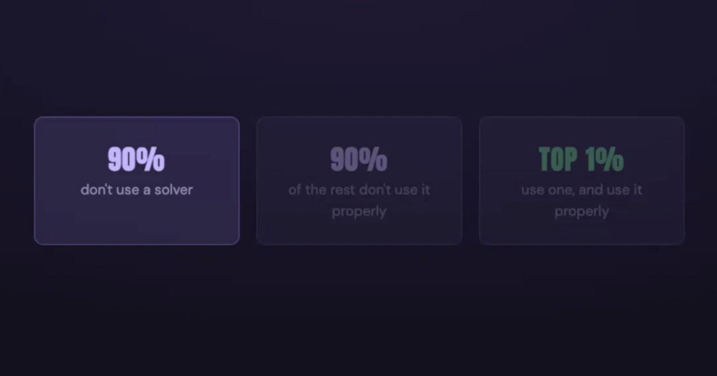
Training 101 · An introduction to Claude
34
Notes:
Call back to the 3% from chapter 1. The team came in as part of the pack and leaves ahead of it. Then move to next steps.

Slide 53
If you want the results of the top 1%, you need to do what the top 1% are doing
Training 101 · An introduction to Claude
34
Notes:
Call back to the 3% from chapter 1. The team came in as part of the pack and leaves ahead of it. Then move to next steps.

Slide 54
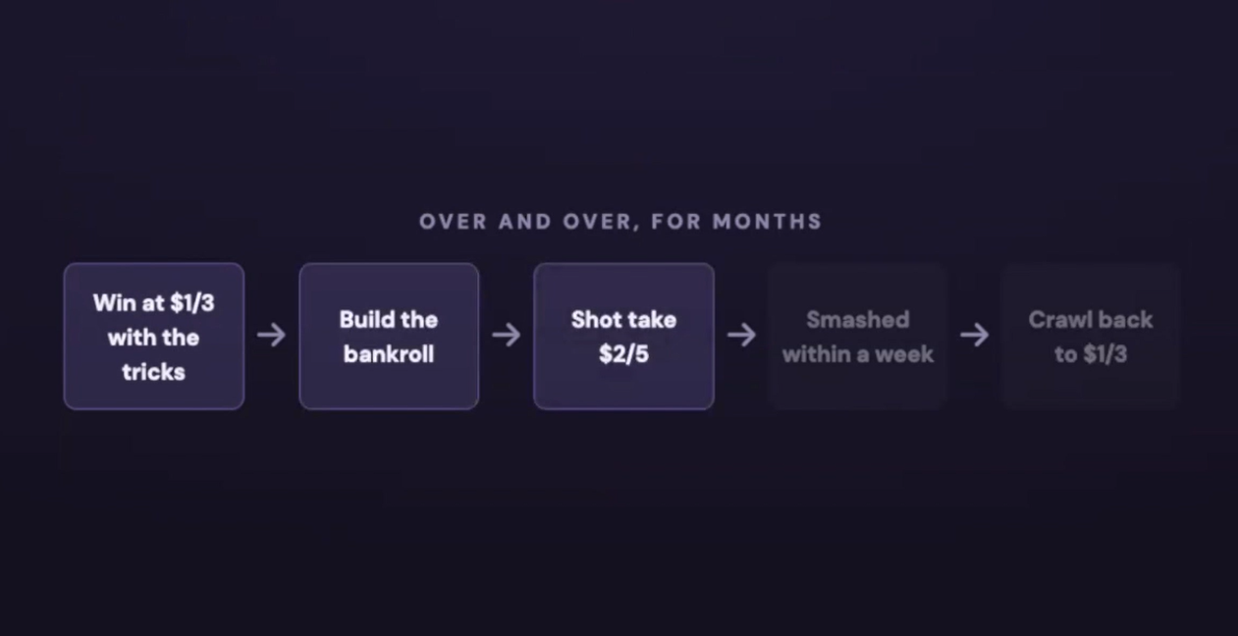
Story
Training 101 · An introduction to Claude
34
Notes:
Call back to the 3% from chapter 1. The team came in as part of the pack and leaves ahead of it. Then move to next steps.

Slide 55
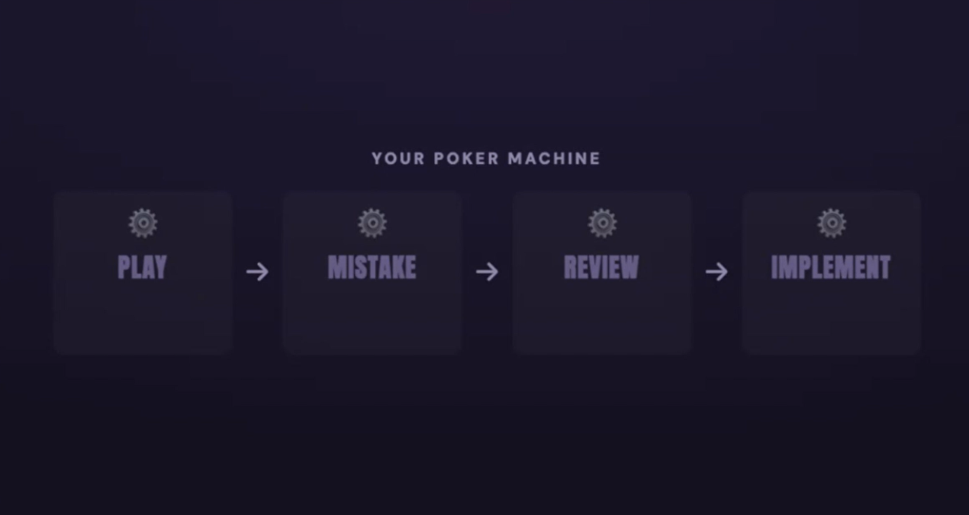
Story
Training 101 · An introduction to Claude
34
Notes:
If you miss one cog, the whole machine and system doesn’t work

Slide 56
Story
Doing the same things over and over expecting different results
Training 101 · An introduction to Claude
34

Slide 57
Automating tedious tasks
What does it actually look like?
Scheduling tasks
An assistant with your work
Training 101 · An introduction to Claude
34
Notes:
Call back to the 3% from chapter 1. The team came in as part of the pack and leaves ahead of it. Then move to next steps.

